Slide 1
Chapter 13:
CSE 3442
Tom Rethard

Slide 2
8253/54 Timer
PC has 1 clock
  Highest frequency in system
  Signal can be divided to give lower frequencies
Programmable Interval Timer (PIT)
  Lowers frequency to level for use with the speaker (beep sound) and other uses

Slide 3
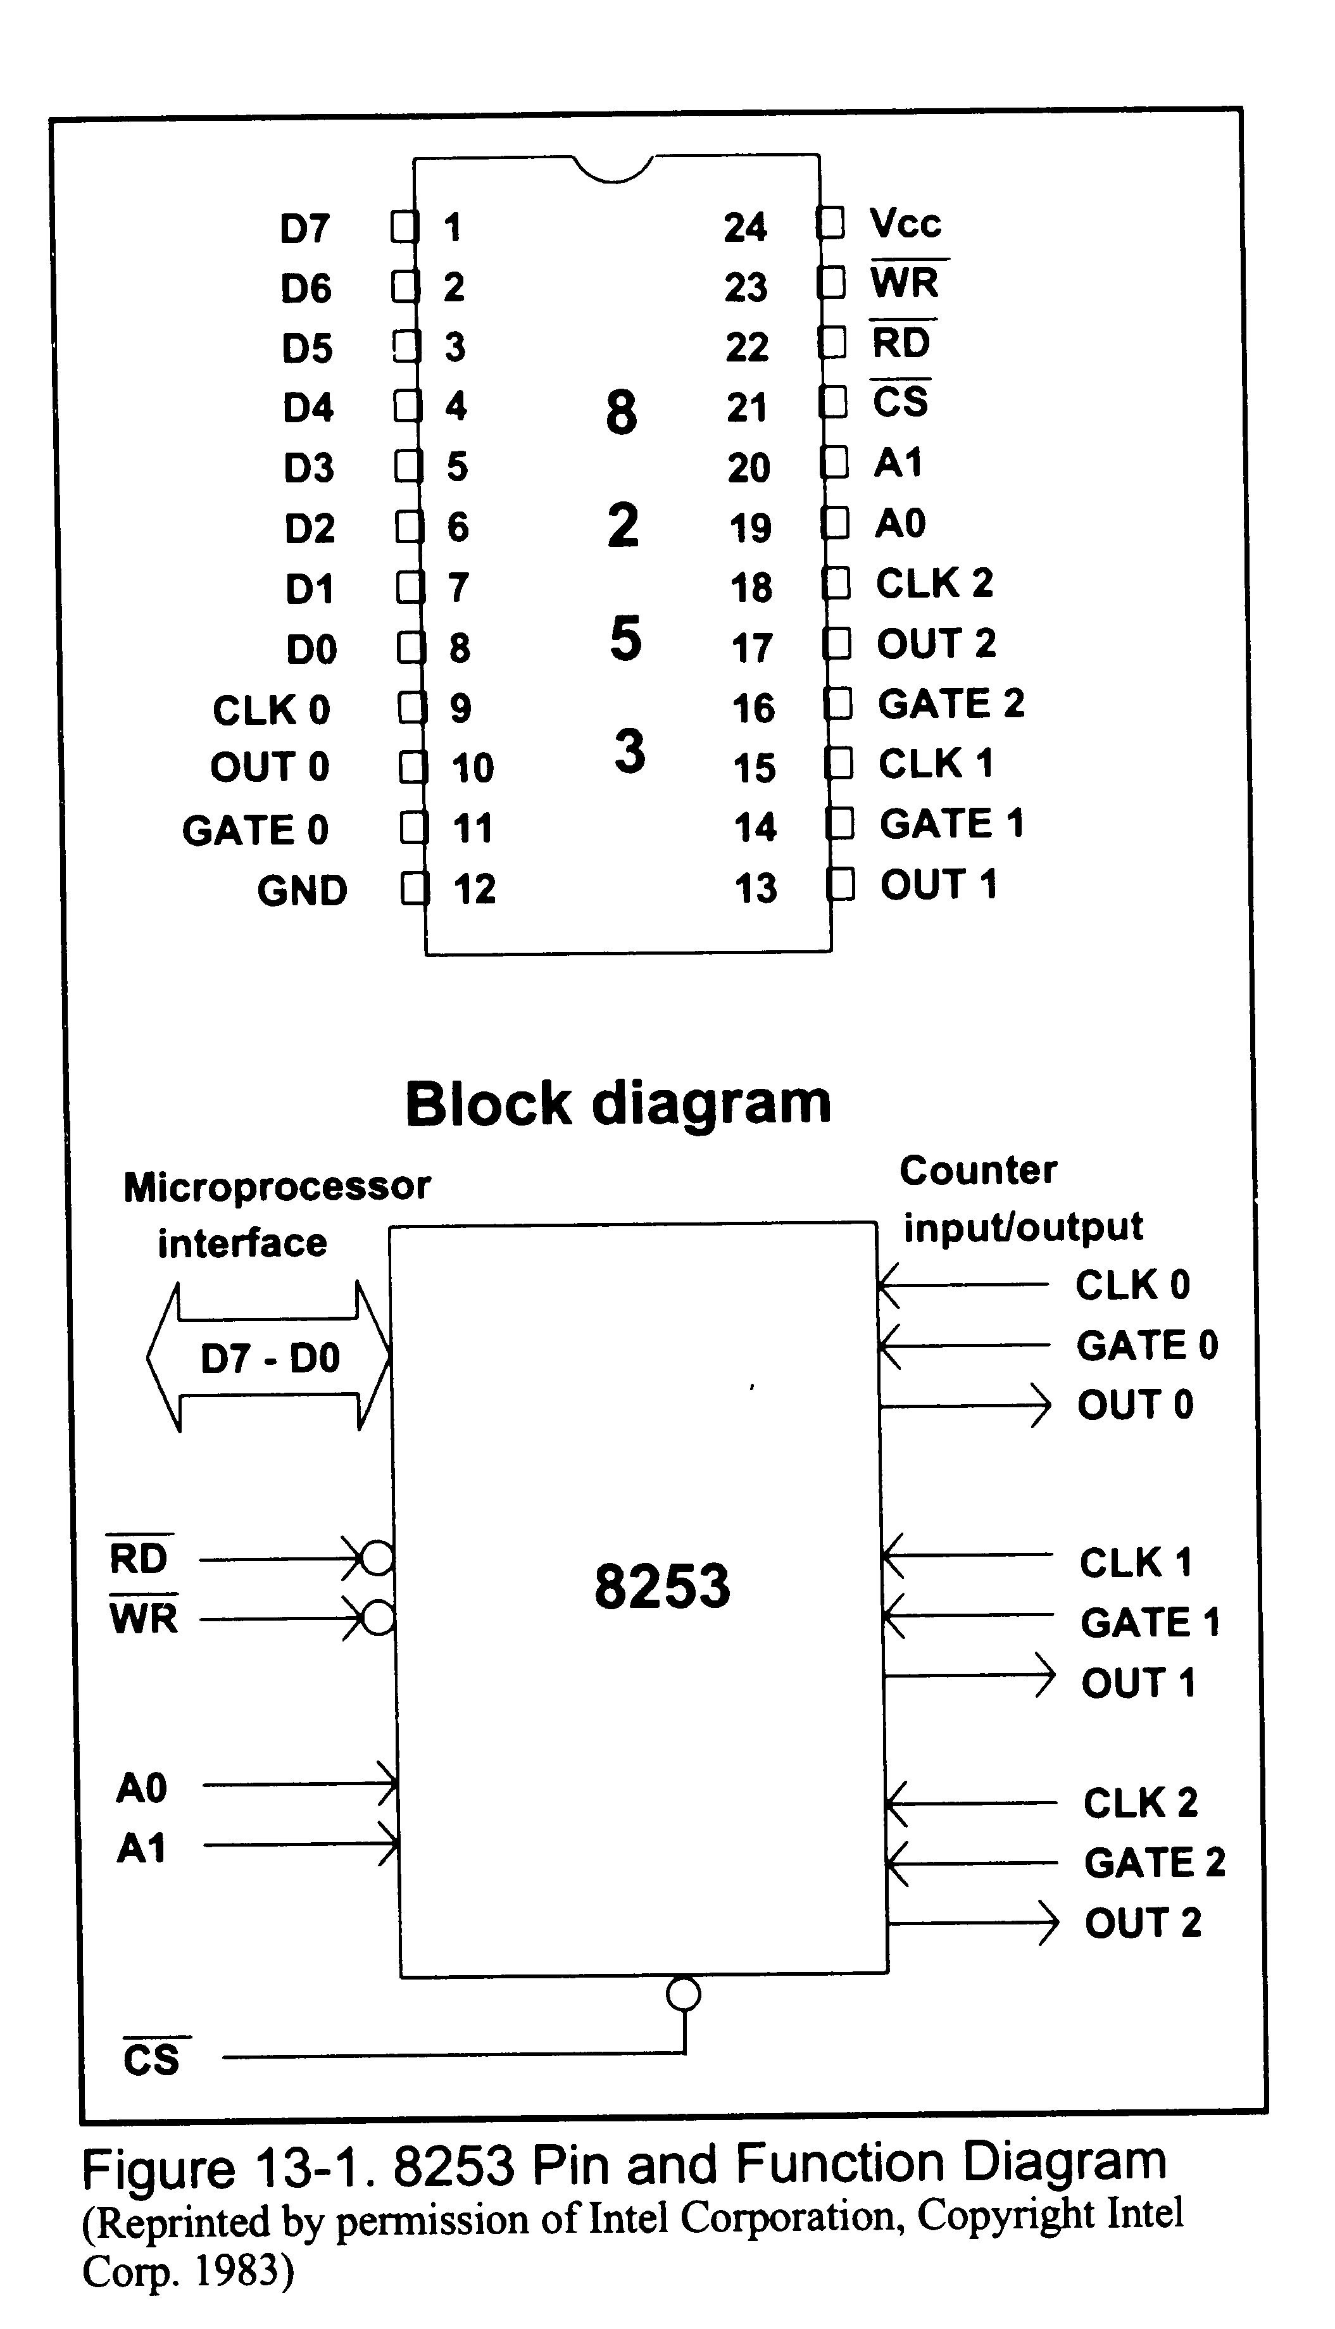
8253 Pins and Functions

Slide 4
8353/54 Pinouts
A0, A1, CS
  Independent counters
  Frequency dividers
  Each on a single port
  Each associated with 3 pins: CLK, GATE and OUT

Slide 5
8353/54 Pinouts
CLK0-CLK2
  External clock – carries input frequency signal (square wave, 33% duty cycle)
  0-2Mhz on PC
OUT0-OUT2
  Can program wave shape: square wave, one-shot
  Various duty cycles
  No sine waves or saw-tooth shapes

Slide 6
8353/54 Pinouts
GATE0-GATE2
  Enables or disables the counter
  Sometimes needs a 0-1 pulse to enable
D0-D7
  Bi-directional connection to data bus
RD and WR – normal uses

Slide 7
Addressing
CS | A1 | A0 | Port
0 | 0 | 0 | Counter 0
0 | 0 | 1 | Counter 1
0 | 1 | 0 | Counter 2
0 | 1 | 1 | Control Register
1 | X | X | 8353/54 not selected

Slide 8
Control Word
Programming the chip requires a one-byte control word (no surprises here!)
Control word is sent to the chip on D0
Mode selection is on D1-D3
Input byte selection in RL0-RL1
Counter Selection in D6-D7

Slide 9
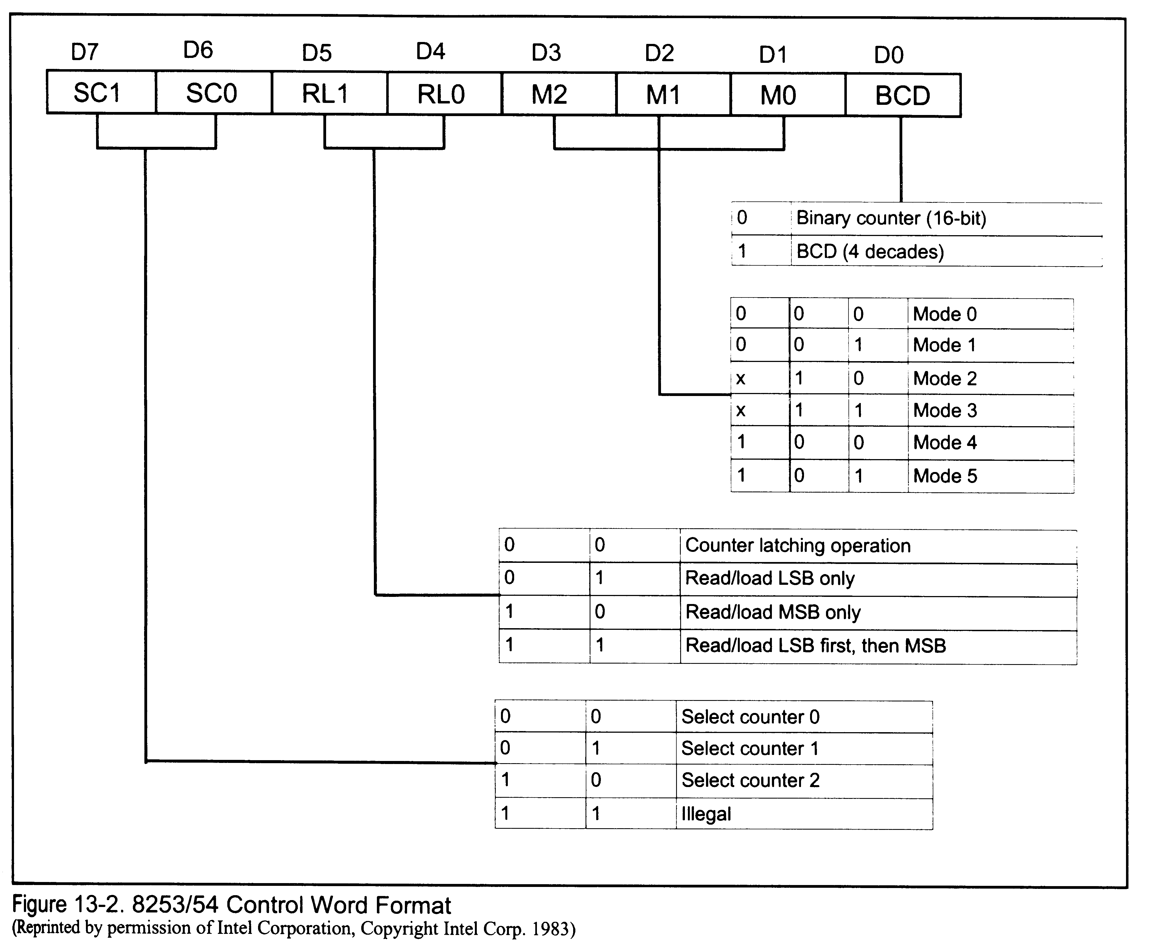
8253/8254 Control Word

Slide 10
8253/54 Control Word
D0
  0: binary divisor (0000H-FFFFH)
  1: BCD divisor (0000-9999)
  Loading 0 actually divides by 10000H or 10000, depending on mode

Slide 11
8253/54 Control Word
D1-D3
  Select shape of output signal
    0 – interrupt on terminal count
    1 – programmable one-shot
    2 – rate generator
    3 – square wave rate generator
    4 – software triggered strobe
    5 – hardware triggered strobe
D6-D7
  Select which counter is used

Slide 12
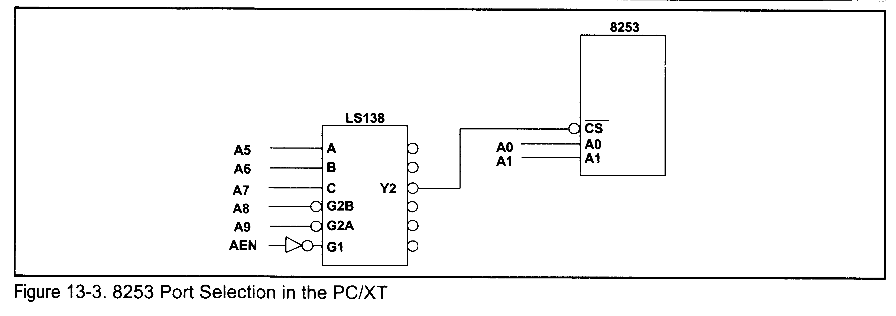
8253 Port Selection in the PC

Slide 13
8253 Port Selection in the PC
Binary | Address
AEN A9 A8 | A7 A6 A5 A4 | A3 A2 A1 A0 | Hex | Function
1 0 0 | 0 1 0 x | x x 0 0 | 40 | Counter 0
1 0 0 | 0 1 0 x | x x 0 1 | 41 | Counter 0
1 0 0 | 0 1 0 x | x x 1 0 | 42 | Counter 0
1 0 0 | 0 1 0 x | x x 1 1 | 43 | Counter 0

Slide 14
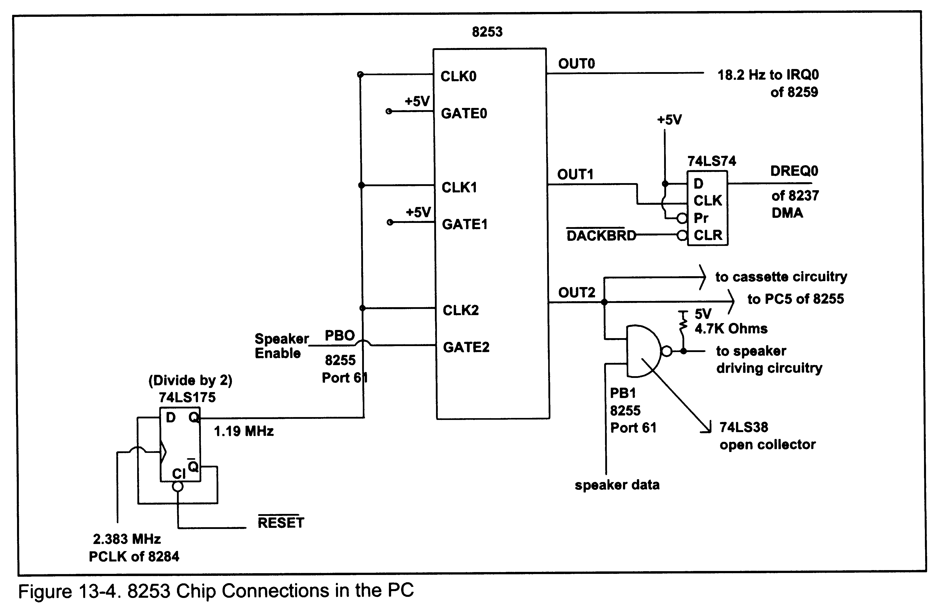
8253 Connections in the PC

Slide 15
Example: Counter 0
Handles time of day clock updating
BIOS uses interrupt to check floppy motor
Interrupt is made available to the user (1CH)

Slide 16
Example: Counter 0
CLK0 is 1.193 MHz
GATE0 connected to high permanently
OUT0 connected to IRQ0 of 8259 (highest priority interrupt) for TOD interrupt
TOD interrupt occurs 18.2 times per second
What is the control word?

Slide 17
Example: Counter 0
Frequency is 18.2 Hz
Freq of CLK0 is 1.193MHz, so must divide 1.193 by x to get 18.2
  Turns out to be 65,536 (0000H)
Wave shape must be square to trigger IR0 on positive edge

Slide 18
Example: Counter 0
D0 = 0 (binary divisor)
D3 D2 D1 = 011 (mode 3)
D4 D5 = 11 (LSB first, MSB second)
D7 D6 = 00 (counter 0)

Slide 19
Example: Counter 2
CLK1 connected to 1.193MHz
GATE1 permanent high
OUT1 periodic pulse for memory refresh
  At least every 15μs (66,728Hz) for each of 128 rows
  Total set refreshed every 2ms
What is control word?

Slide 20
Example: Counter 2
D0 = 0 for binary
D3 D2 D1 = 010 for mode 2 – stays high for 18 pulses and goes low for 1
D5 D4 = 01 for LSB only (don’t need msb)
D7 D6 = 01 for counter 1
Divisor = 1.19318/66,278 = 18

Slide 21
Example: Counter 3
Connected to speaker and PC5 of the 8255 (and even the cassette port)
Used to play music on the speaker
CLK2 connected to 1.19218MHz
GATE2 is programmed by PB0 of port 61H(B)
Beep sound has a freq of 896Hz, mode 3 (square wave) (divisor=1331)

Slide 22
Turning on the Speaker
GATE2 = high
  Set by PB0 of port 61H (B)
OUT2 is ANDed with PB1 and sent to the speaker

Slide 23
Time Delays
Spin loops (8088/86 only)
  Need to be calibrated!
  Just how long does an instruction take?
    17clocks on an 8088/86
286+
  PB4 of port 61H toggles every 15.085μs

Slide 24
Time Delays
WAITF PROC NEAR
PUSH AX
WAITF1:
IN AL,61H
AND AL,10H ; CHECK PB4
CMP AL,AH ; DID IT CHANGE?
JE WAITF1 ; WAIT FOR CHANGE
MOV AH.AL ; SAVE NEW STATUS
LOOP WAITF1 ; CONTINUE UNTIL CX=0
POP AX
RET
WAITF ENDP

Slide 25
Generating Music
Basic chromatic scale
Organized into octaves
Each octave represents a doubling of frequency
Scale is centered around concert pitch of A₄=440Hz (A above middle C)

Slide 26
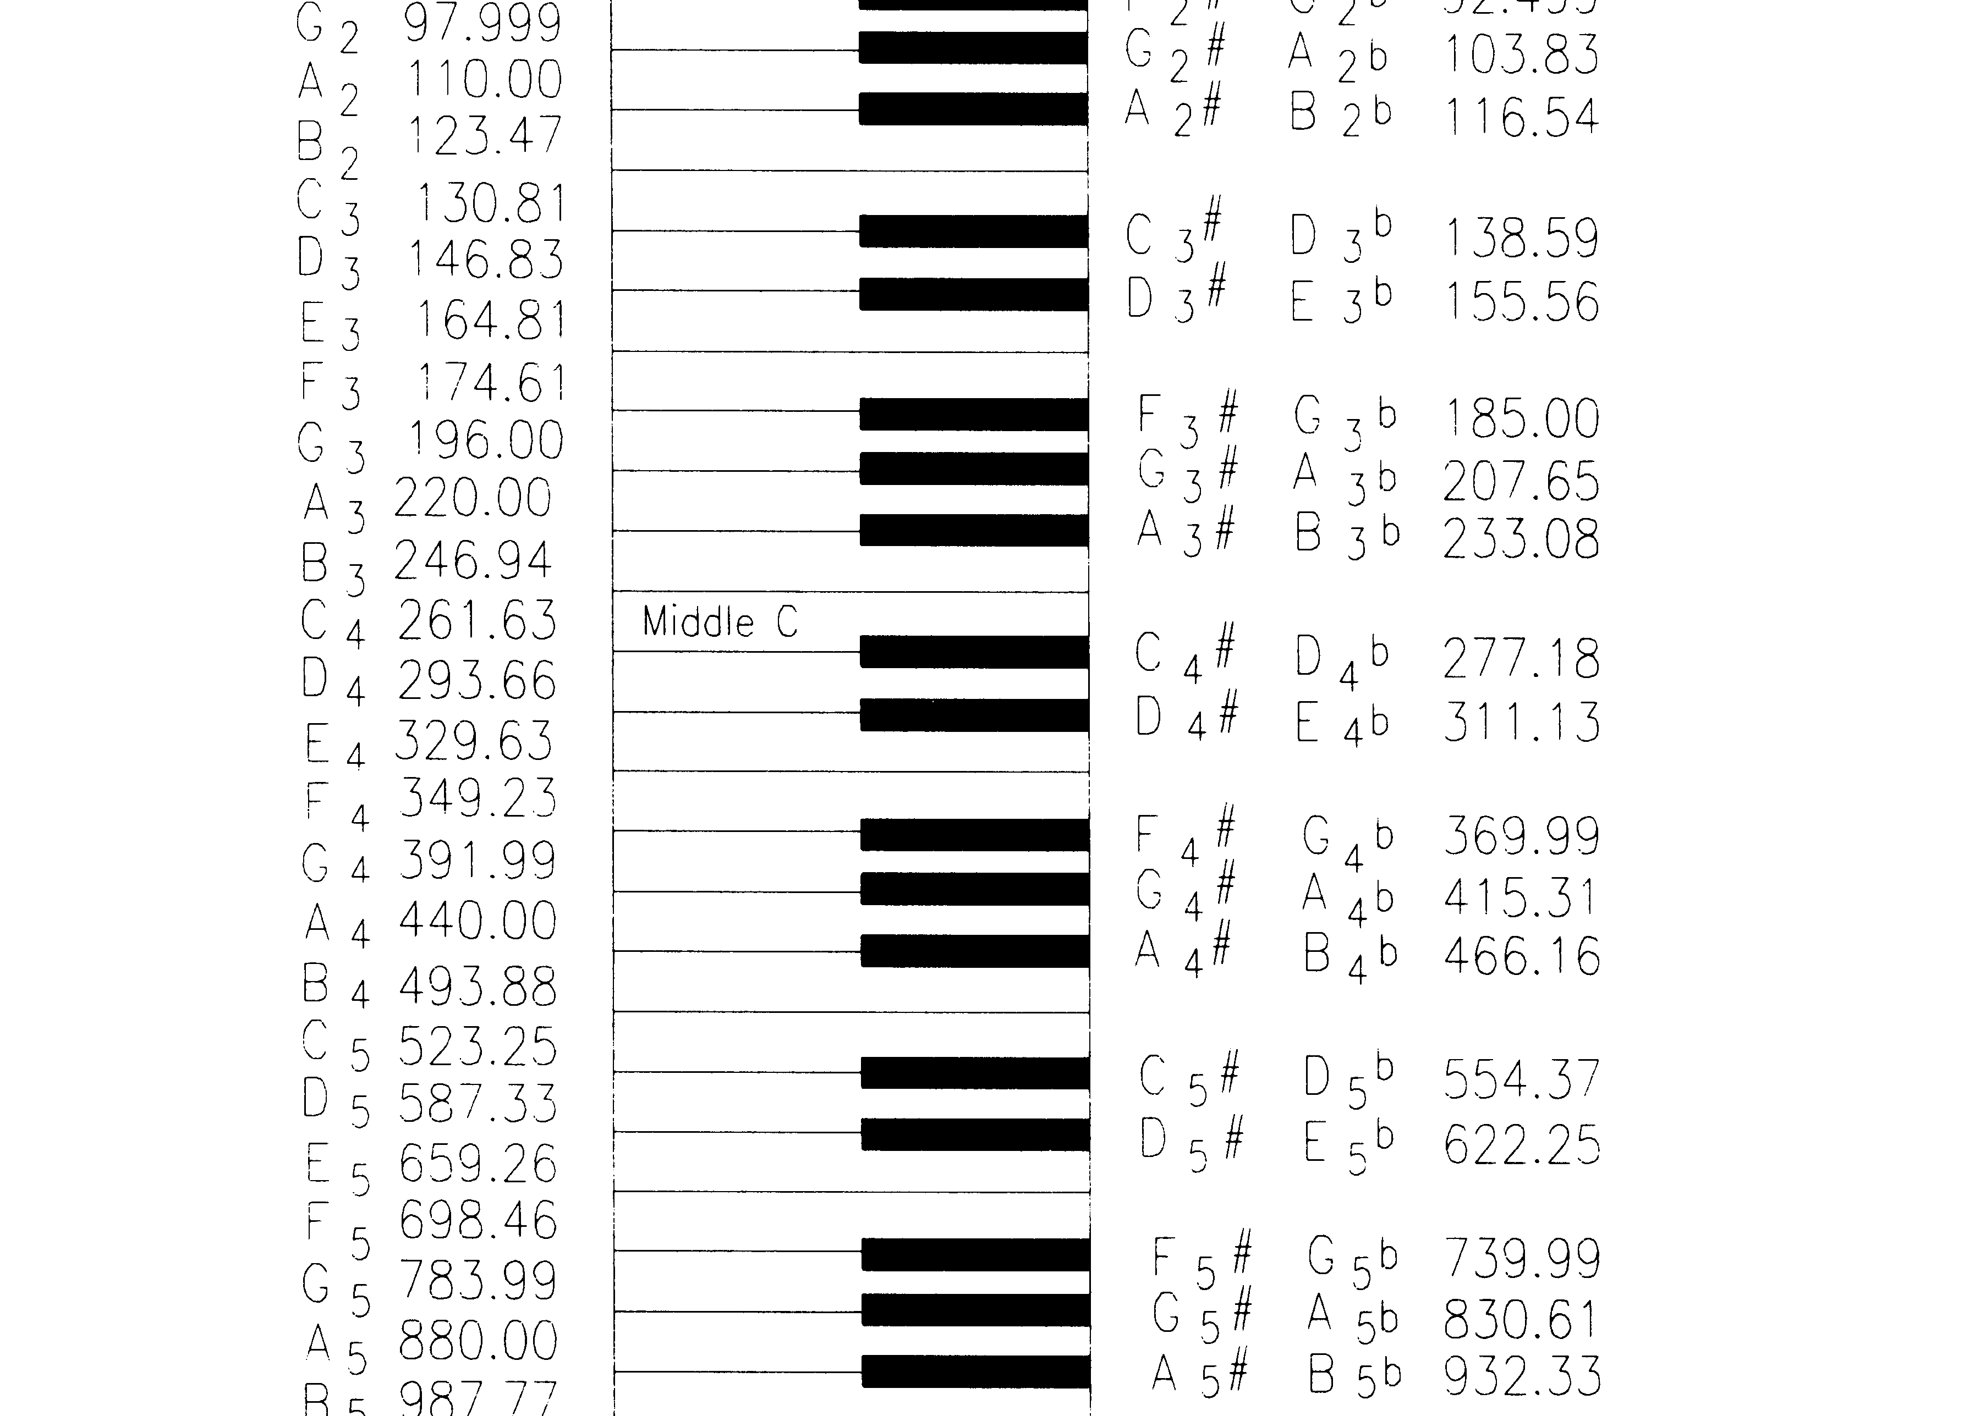
The Piano Keyboard

Slide 27
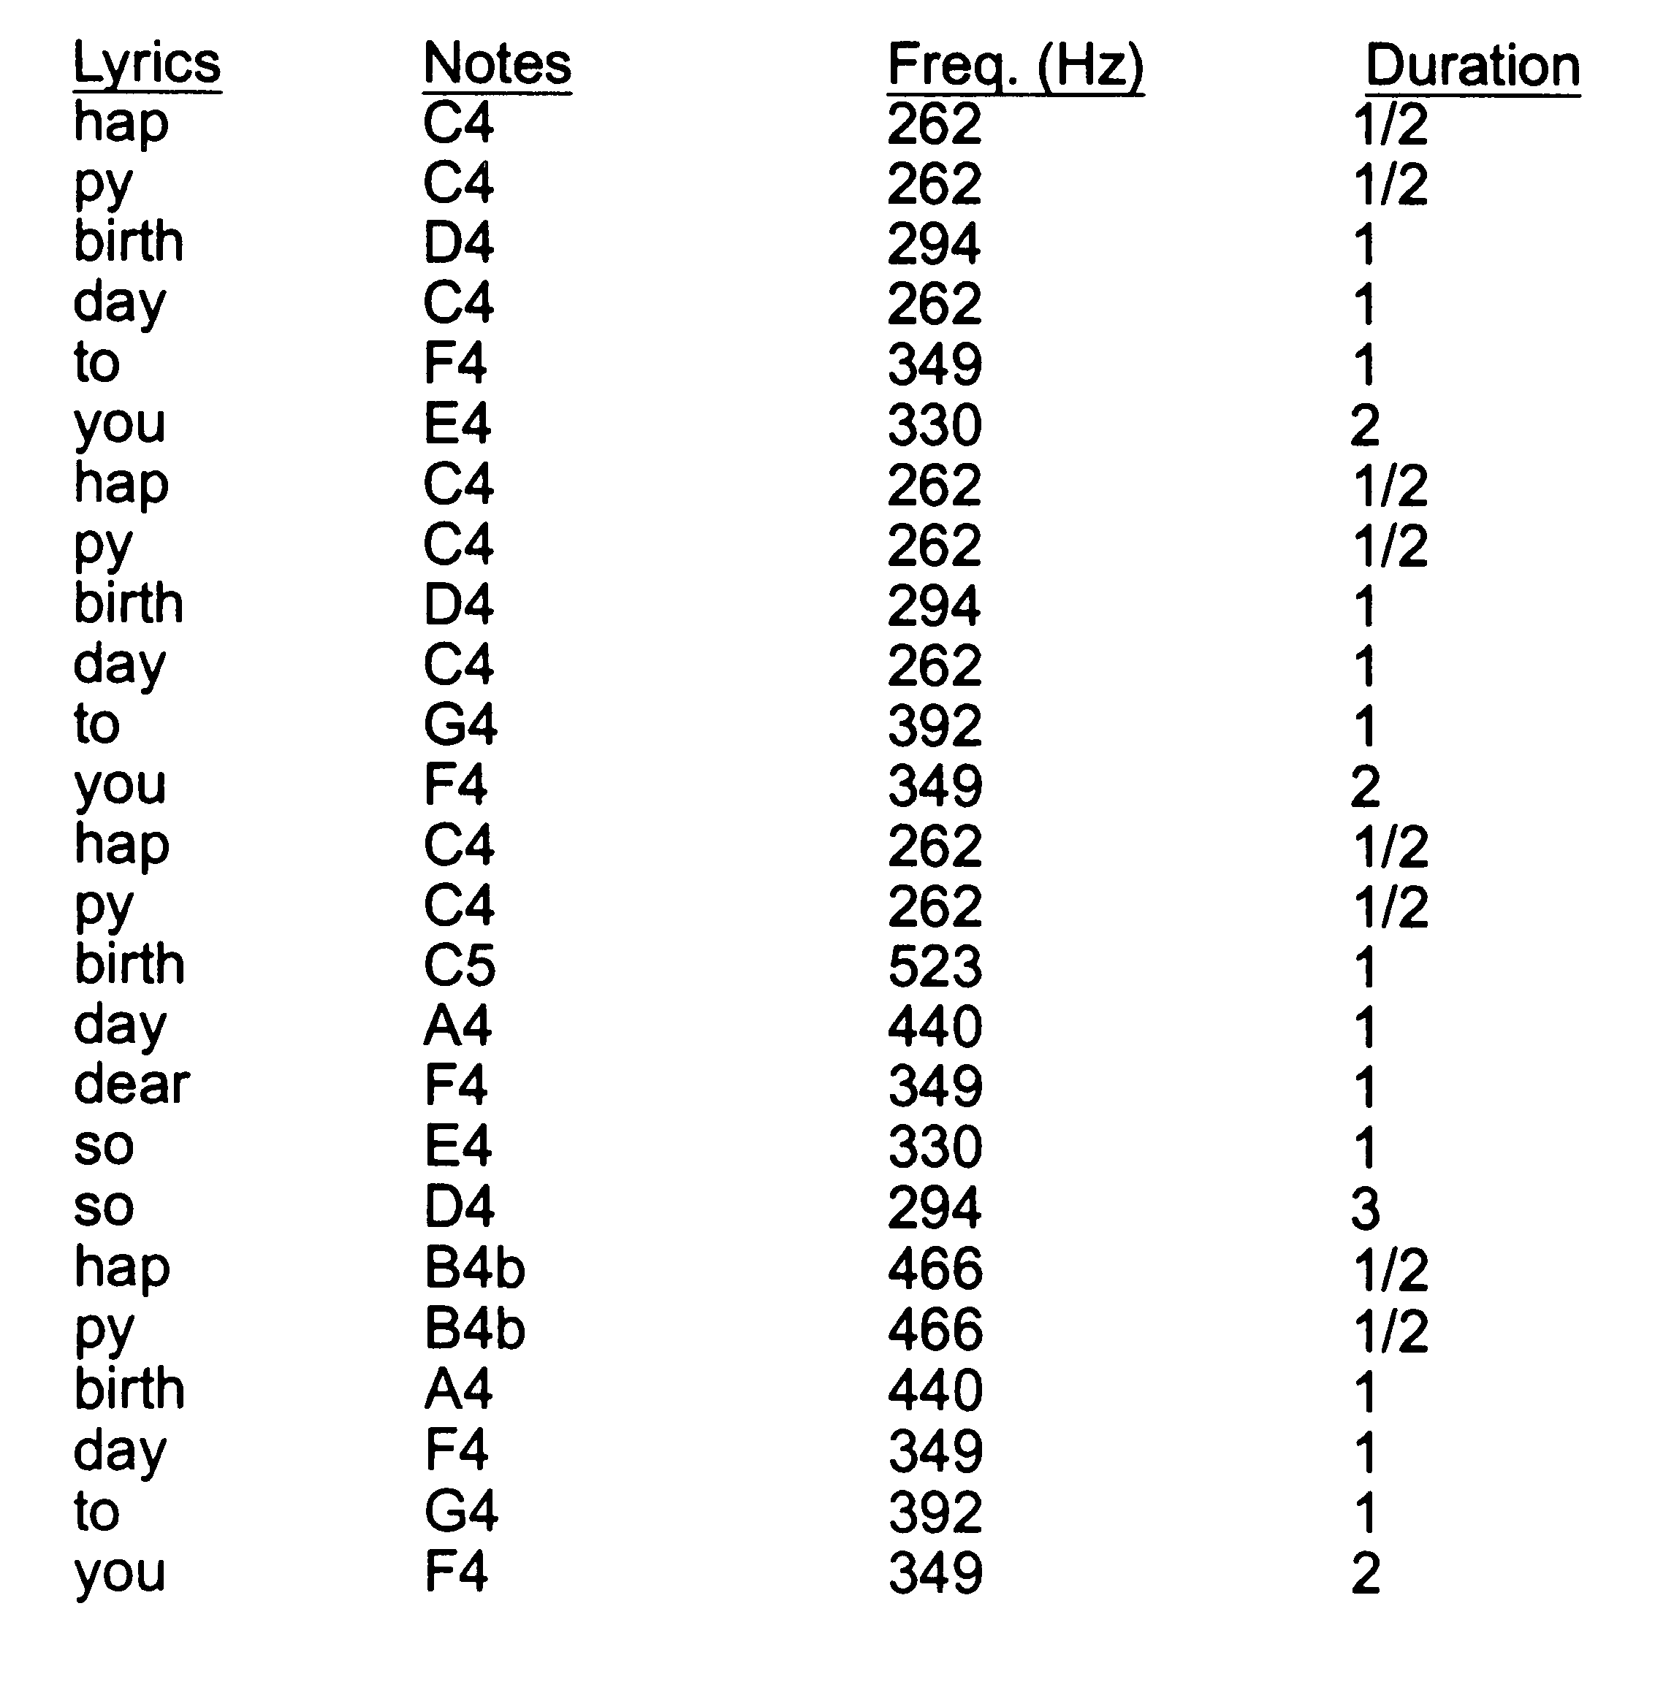
Happy Birthday

Slide 28
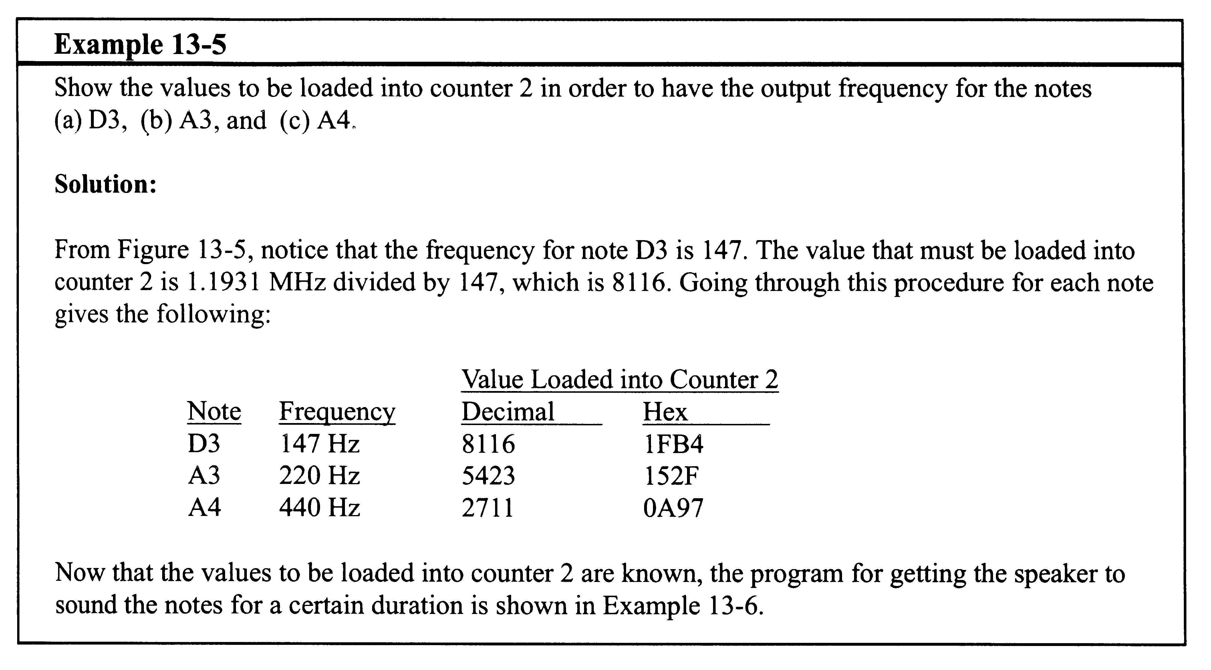
Example 13-5

Slide 29
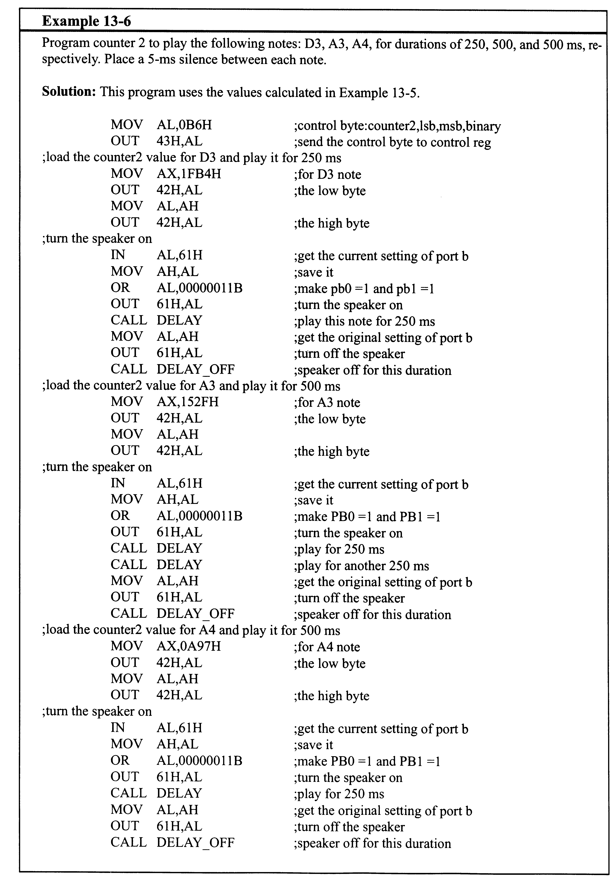
Example 13-6, Part 1

Slide 30
Example 13-6, Part 2

Slide 31
Wave Shapes
Mode 0
  Interrupt on terminal count
  If output is initially low, will remain low for duration of count if GATE = 1
  Width of low pulse = N x T
    N = clock count loaded into counter
    T = clock period
  When terminal count is reached, the output goes high

Slide 32
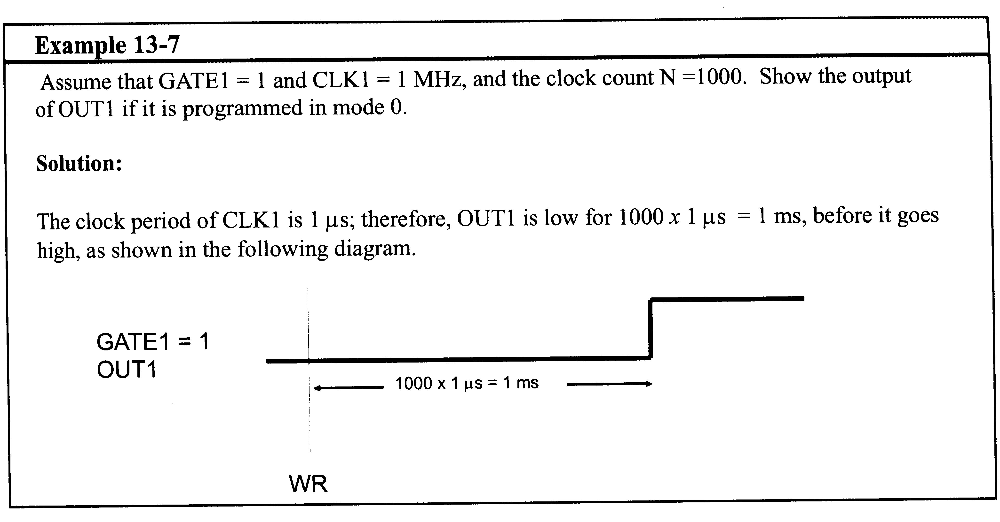
Example 13-7

Slide 33
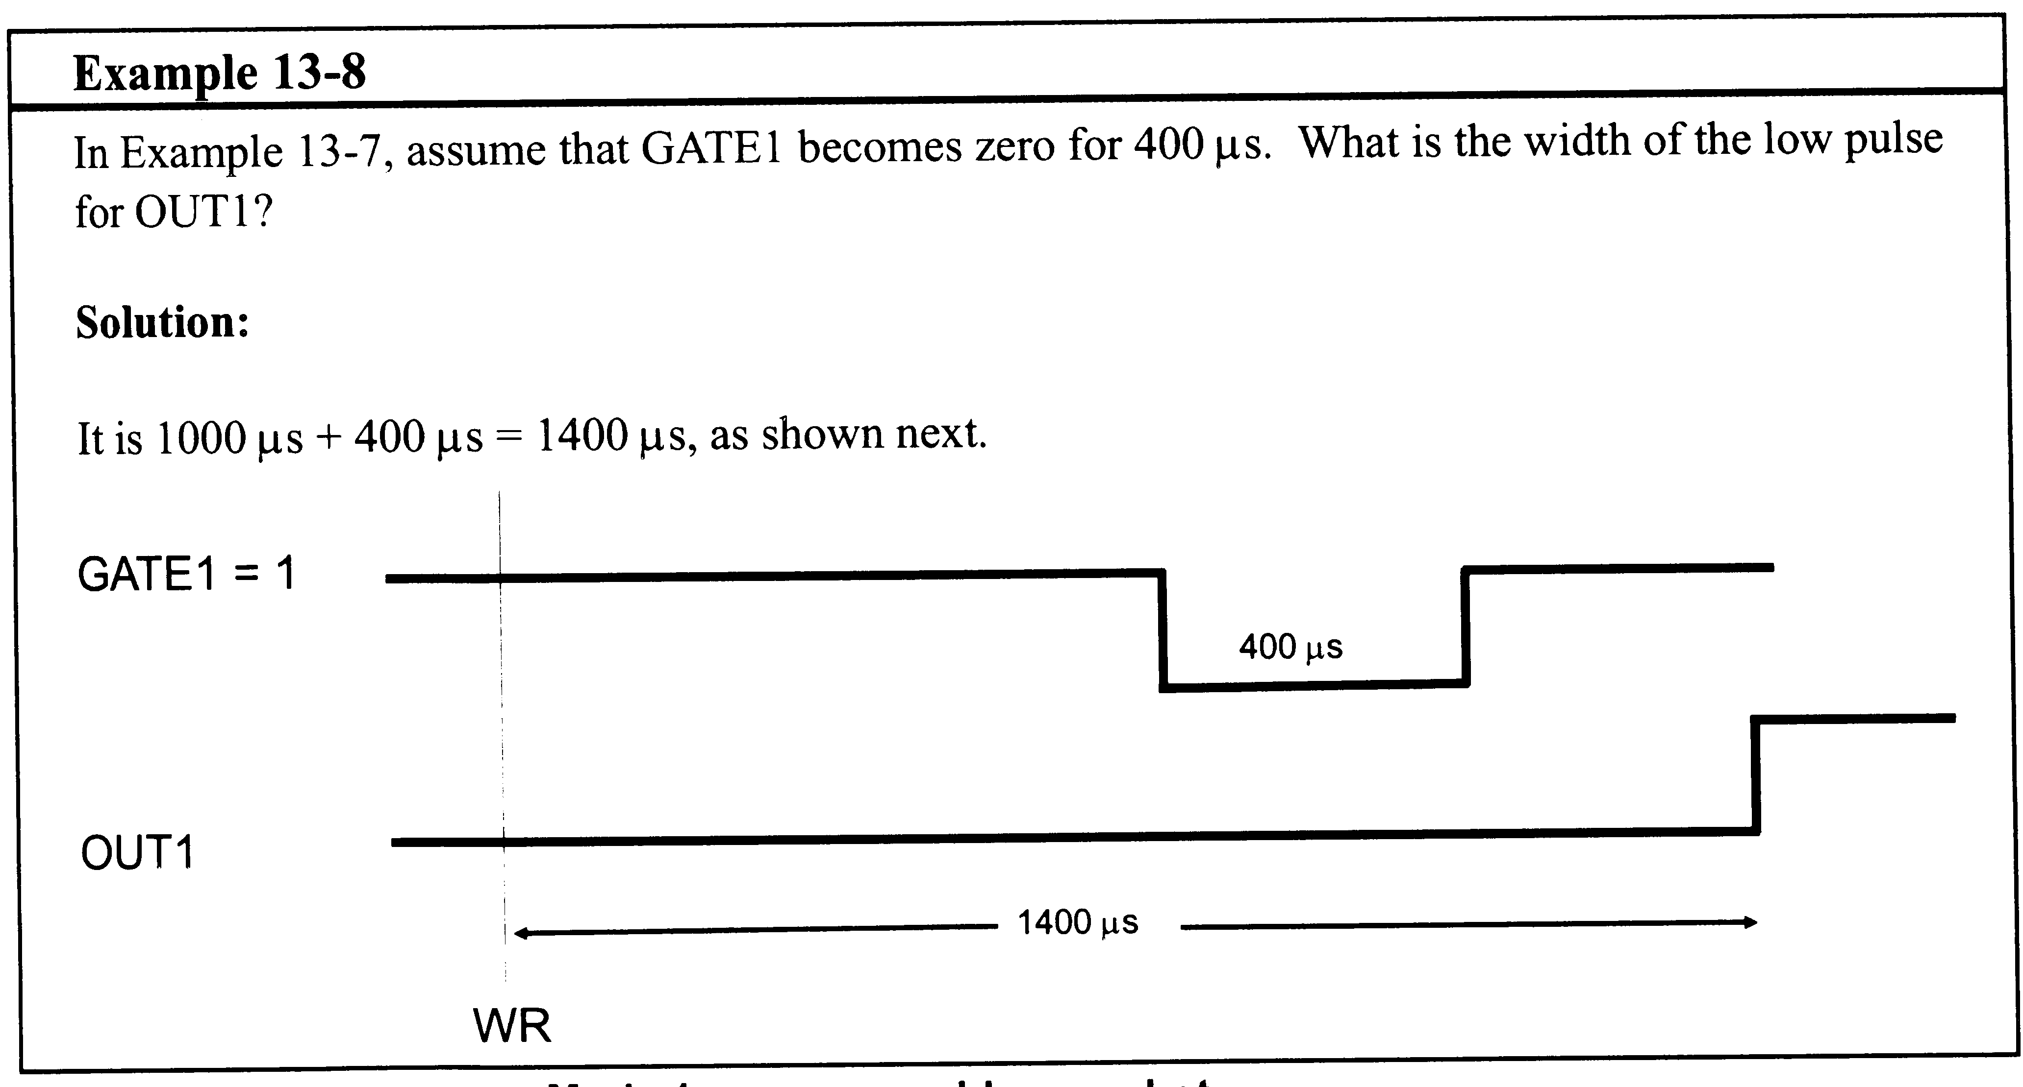
Example 13-8

Slide 34
Wave Shapes
Mode 1
  Programmable one-shot
    Also hardware triggerable one-shot
  Two step process
    Load count registers
    Send 0-to-1 pulse on GATE to trigger it
  When triggered, output goes low and stays low for N x T, then goes high

Slide 35
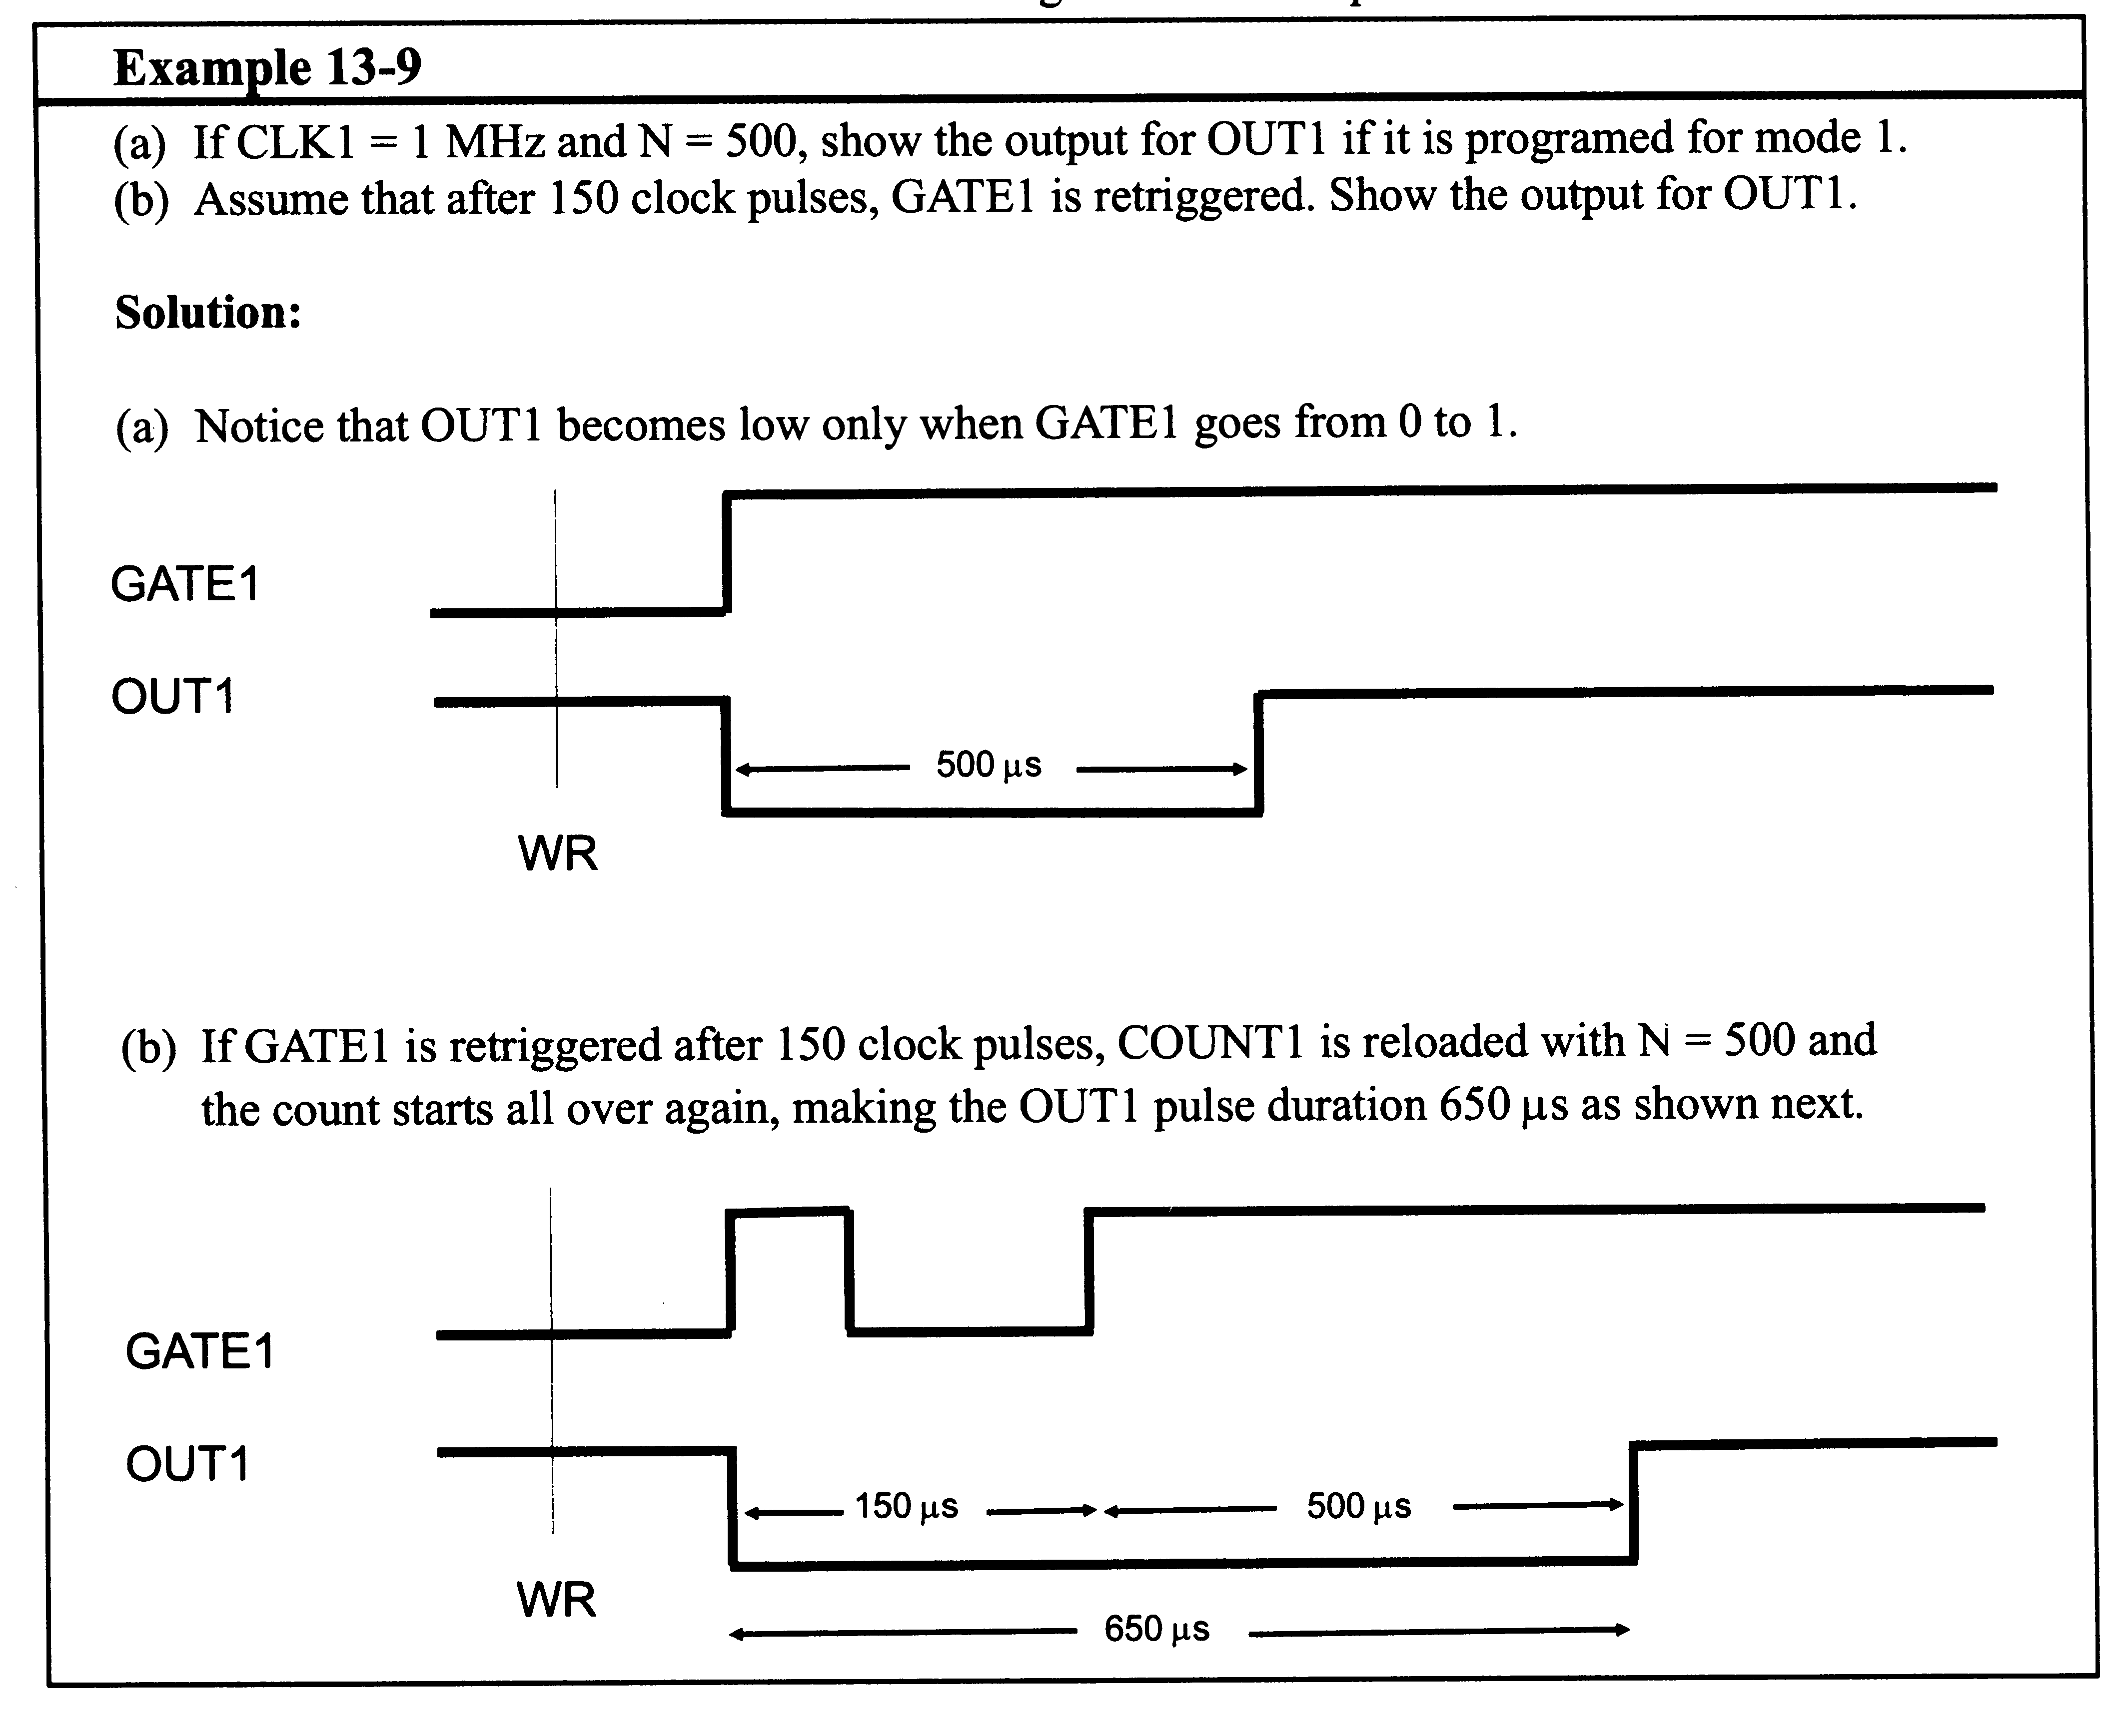
Example 13-9

Slide 36
Wave Shapes
Mode 2
  Rate generator or divide-by-N counter
  If GATE = 1, OUT is high for N x T, goes low for 1 clock pulse, then reloads the count
  Period of OUT = (N+1) / T

Slide 37
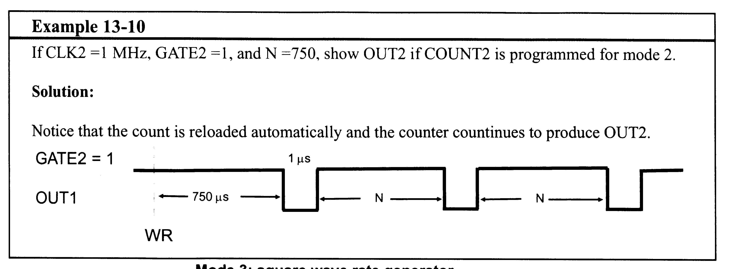
Example 13-10

Slide 38
Wave Shapes
Mode 3
  Square wave generator
  If GATE=1, OUT is a square wave (50% duty, or slightly off if N is odd)
  Count is automagically reloaded

Slide 39
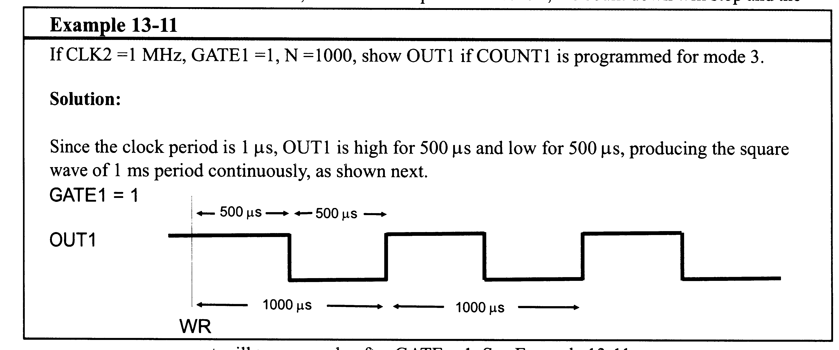
Example 13-11

Slide 40
Wave Shapes
Mode 4
  Software triggered strobe
  If GATE =1, OUT goes high when count is loaded, stays high for N x T, goes low for 1 clock when count→0
  Count must be reloaded to repeat the strobe
  Similar to mode 2, but not automatically reloaded
  If GATE→low, the OUT → high and count stops; count resumes when GATE→high

Slide 41
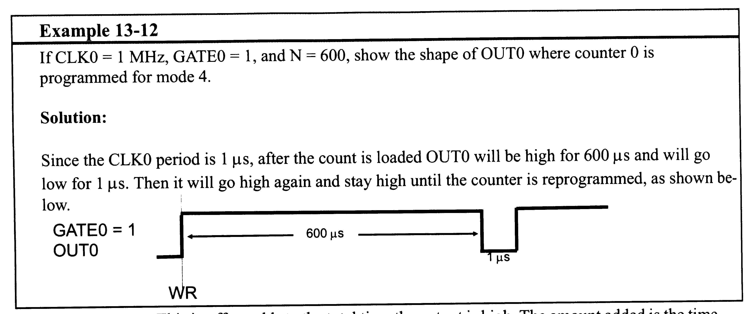
Example 13-12

Slide 42
Wave Shapes
Mode 5
  Hardware triggered strobe
  Like mode 4, but triggering is done with GATE instead
  Count begins when 0-1 pulse hits GATE

Slide 43
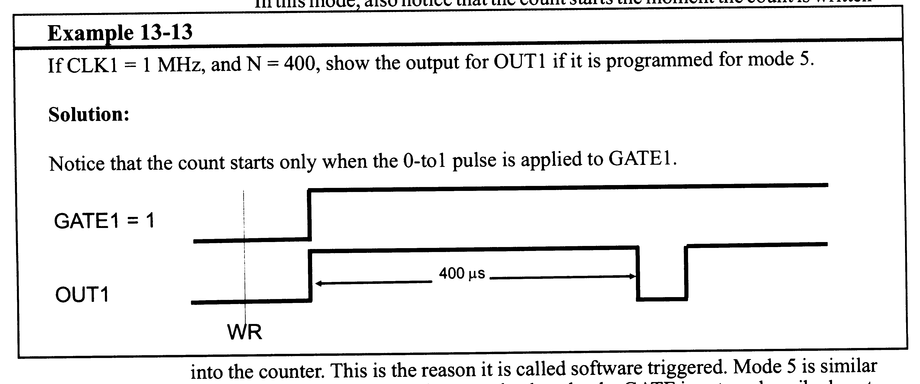
Example 13-13

Slide 44
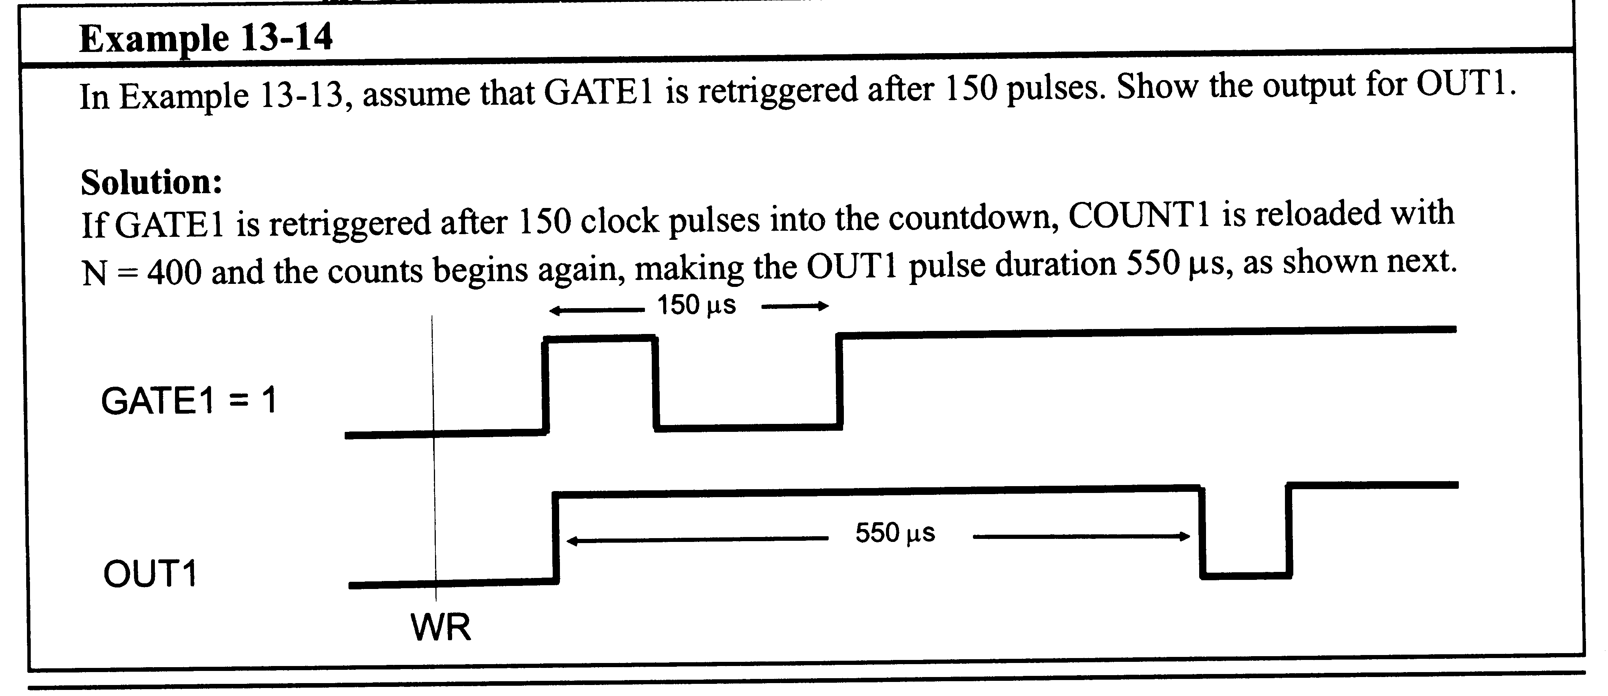
Example 13-14

Slide 45
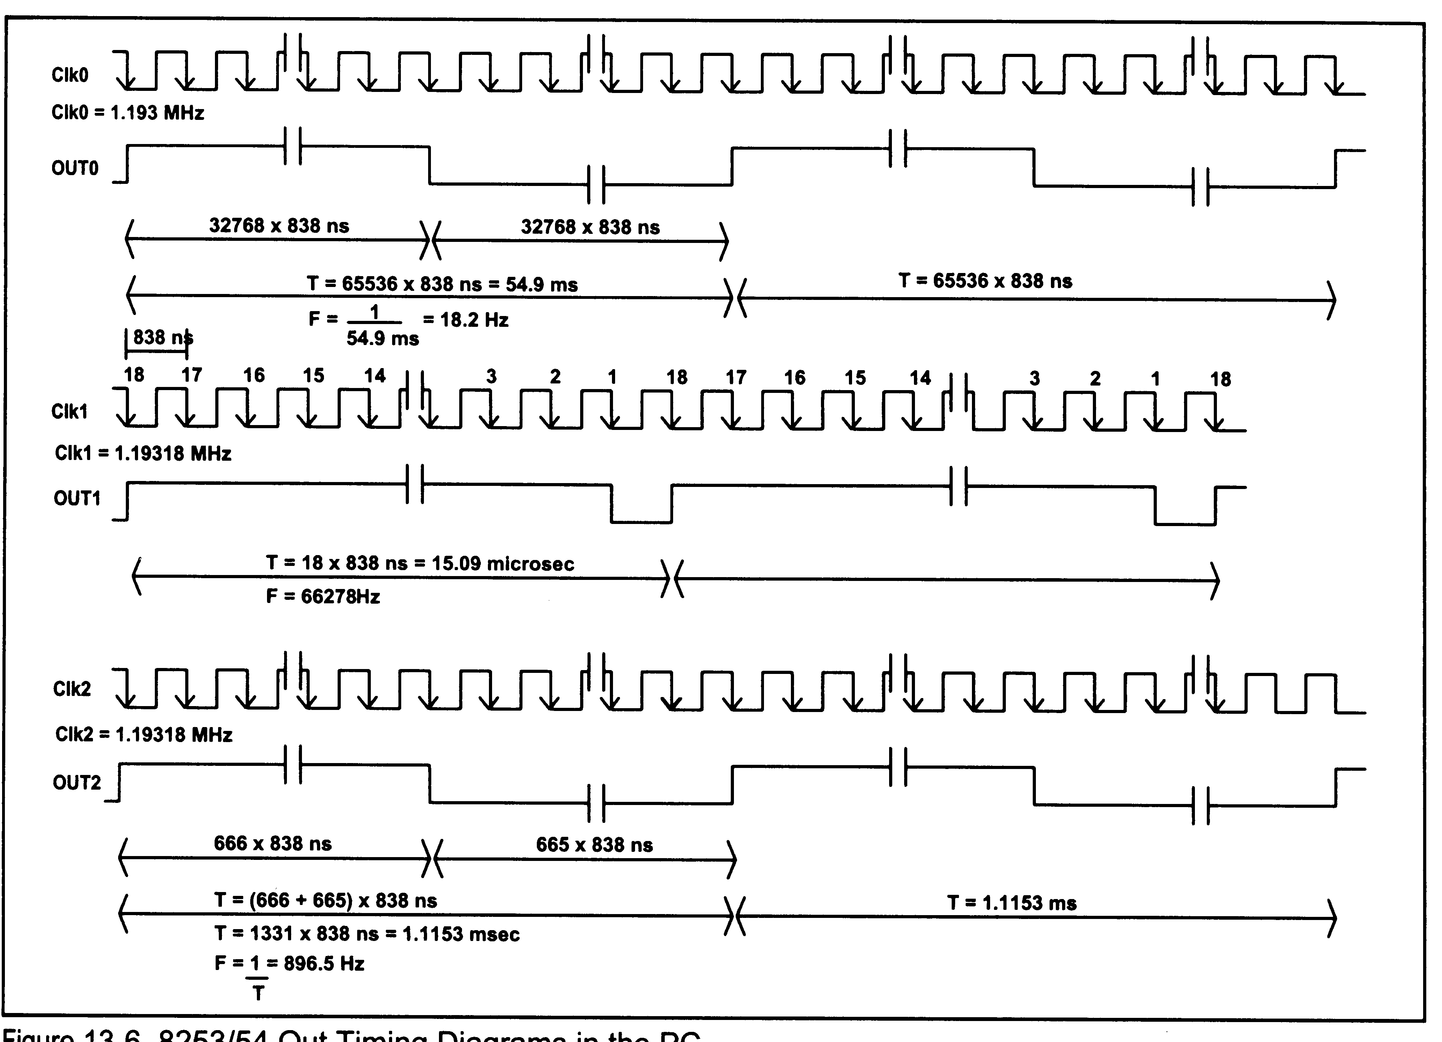
8253/54 Out Timings

